Slide 1
Chap.9 Graph

Slide 2
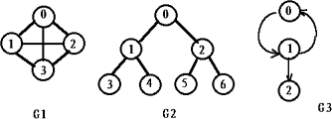
Graph Terminology
A graph G(V,E) consists of a set V of vertices and a set E of linking pairs of vertices. These pairs of vertices are called edges.
Undirected graph: If each ( v_{i} , v_{j} ) in the E is undirected, that is ( v_{i} , v_{j} ) = ( v_{j} , v_{i} ) ::= the same edge.
Directed graph (Digraph): If each < v_{i} , v_{j} > in the E is directed, < v_{i} , v_{j} > ::= ≠ < v_{j} , v_{i} >
In directed graph, the edges is also called arcs（弧）.
v_{i}
v_{j}
tail
head

Slide 3
Terminology
V(G1) = {0, 1, 2, 3} E(G1) = { (0,1), (0,2), (0,3), (1,2),(1,3), (2,3) }
V(G2) = {0, 1, 2, 3, 4, 5, 6} E(G2) = { (0,1), (0,2), (1,3), (1,4), (2,5), (2,6) }
V(G3) = {0, 1, 2} E(G3) = { < 0, 1 >, < 1, 0 >, < 1, 2 > }
G1 and G2 are undirected graphs, and G3 is a directed graph.

Slide 4


Terminology
Complete Graph ----- a graph that has the maximum number
of edges
  Directed Graph (n vertices)
  Undirected Graph (n vertices)
0
1
3
2
0
1
3
2

Slide 5
Terminology
v_{i} and v_{j} are adjacent ;
( v_{i} , v_{j} ) is incident on v_{i} and v_{j}
v_{i}
v_{j}
v_{i} is adjacent to v_{j} ; v_{j} is adjacent from v_{i} ;
< v_{i} , v_{j} > is incident on v_{i} and v_{j}
v_{i}
v_{j}
Weighted graph ----- each edge of the graph has a weight.

Slide 6
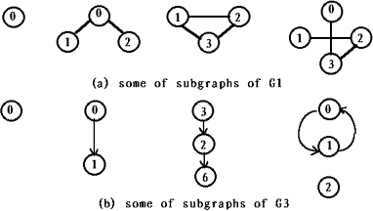

Terminology
Subgraph : Assume there are two graphs G=(V,E) and G’=(V’,E’). if V’⊆V, and E’ ⊆E, G’ is called subgraph of G, G’ ⊂ G .
graph G1
some of subgraphs of G1
Simple graph : A graph or digraph which does not have any self-loop or parallel edges.
0
1
0
1
2

Slide 7
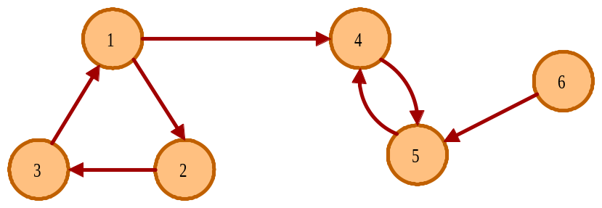
Terminology
Path (⊂ G) from v_{p} to v_{q} ----- a sequence of vertices{ v_{p} ,v_{i1} ,v_{i2} ,…, v_{in} , v_{q} }such that ( v_{p} ,v_{i1} ), ( v_{i1} ,v_{i2} ), …, ( v_{in},v_{q} ) or <v_{p} ,v_{i1}>, <v_{i1} ,v_{i2}>, …, < v_{in} ,v_{q} > belong to E(G)
Length of a Path ---- the number of edges on the path
Simple Path ---- a path in which all vertices , except possibly the first and the last are distinct, that is v_{i1}, v_{i2}, ⋅⋅⋅, v_{in} are distinct

Slide 8
Terminology
Cycle ---- a simple path in which the first and the last vertices are
the same.
Acycle ---- a graph without cycles.
Directed acycle graph (DAG) ---- a directed graph without cycles.

Slide 9
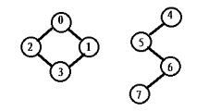
Terminology
v_{i} and v_{j} are connected ----- there is a path from v_{i} to v_{j}
An undirected graph is connected ------ if , for every pair of distinct vertices v_{i} , v_{j} , there is a path from v_{i} to v_{j} in G.
A tree ---- a graph that is connected and acyclic
Connected component ( undirected graph) ----- a maximal connected subgraph.

Slide 10
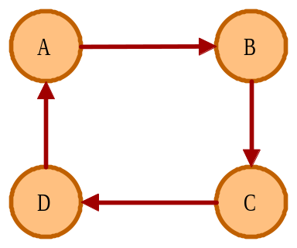
Terminology
Strongly connected ( directed graph ) ------ if , for every pair of vertices v_{i} , v_{j} in G, there is a path from v_{i} to v_{j} , and also from v_{j} to v_{i}.
Weakly connected ( directed graph ) ------ For a directed graph G, if the undirected graph obtained by suppressing the directions on the edges of G is connected.
Strongly connected component ----- a maximal subgraph that is strongly connected.
strongly connected
weakly connected

Slide 11

Terminology
Degree( v) ---- the number of edges incident to the vertex v. For a directed G, we have in-degree and out-degree.
  In-degree ---- the number of edges that have v as the head.
  Out-degree ---- the number of edges that have v as the tail.
v
in-degree(v) = 3; out-degree(v) = 1; degree(v) = 4
Given G with n vertices and e edges, then

Slide 12
Adjacency Matrix （邻接矩阵）
Graph Representation
Adjacency List （邻接链表）

Slide 13
Adjacency Matrix
Graph Representation
A graph may be represented by a two-dimensional matrix.
If G(V,E) has n vertices, let A[n][n] be an n×n matrix whose entries are defined by:
if (v_{i},v_{j})/<vi,vj> is an edge
0 otherwise
A[i][j]=

Slide 14
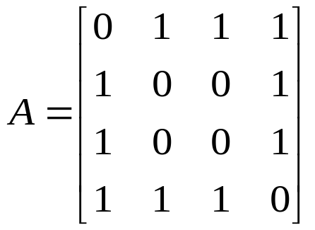
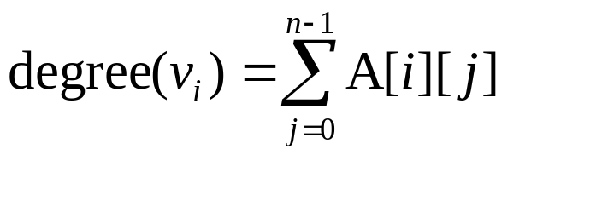
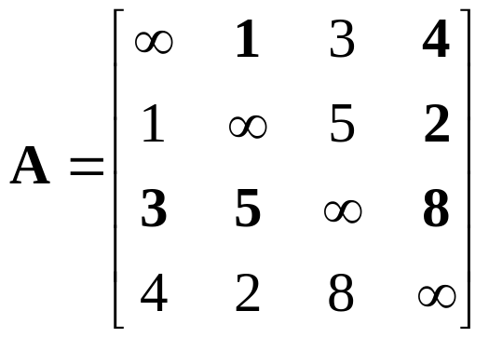
Adjacency Matrix For an Undirected Graph
Unweighted graph:
if (v_{i},v_{j}) ∈E(G)
0 otherwise
A[i][j]=
Symmetric
Degree (v_{i})=?
v₀
v₁
v₃
v₂
Weighted graph:
w_{ij} if (v_{i},v_{j})∈E, w_{ij} is the weight of (vi,vj)
∝ otherwise
A[i][j]=
8
v₂
v₃
3
5
2
4
v₀
v₁
1

Slide 15
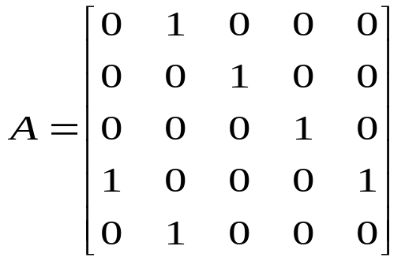
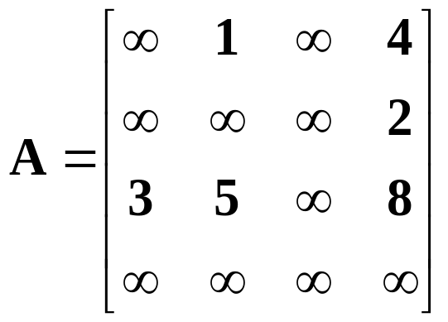
Adjacency Matrix For a Digraph
Unweighted digraph:
if <v_{i},v_{j}> ∈E(G)
0 otherwise
A[i][j]=
In-degree(v_{i})?
Out-degree ( v_{i})?
Degree ( v_{i})?
0
1
4
3
2
Weighted digraph:
w_{ij} if <v_{i},v_{j}>∈E, w_{ij} is the weight with <v_{i},v_{j}>
∝ otherwise
A_{ij}=
8
2
3
3
5
2
4
0
1
1

Slide 16
Matrix Representation of Graphs
广州
佛山
惠州
东莞
中山
深圳
珠海

Slide 17
Operations on Matrix Representation of Graphs
#define MAX_VEX 30
typedef enum {DG, AG, WDG,WAG} GraphKind ;
typedef struct
  { GraphKind kind ; /* type of the graph */
    int vexnum , arcnum ;
    VexType vexs[MAX_VEX];
    /* array saving vertices */
    int adj[MAX_VEX][MAX_VEX];
    /* adjacent matrix*/
    }MGraph ;
MGraph
GraphKind kind
int vexnum
int arcnum
VexType vexs[ ]
int adj[ ][ ]

Slide 18
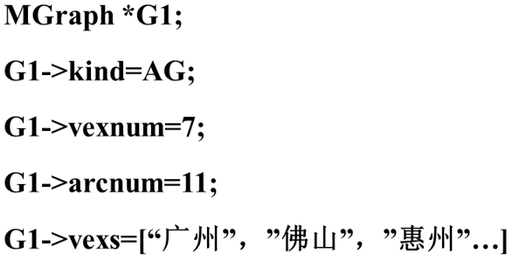
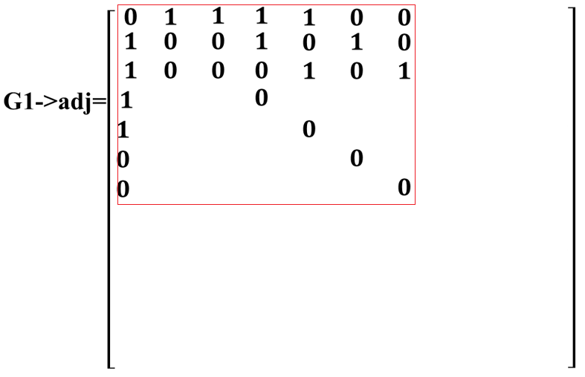
0
1
广州
佛山
2
4
惠州
3
东莞
中山
6
5
深圳
珠海

Slide 19
Create a Graph
MGraph *Create_Graph(MGraph * G)
  { printf(“Input the type of the graph”) ;
    scanf(“%d”, &G->kind) ;
    G->vexnum=0 ;
    return(G) ;
  }

Slide 20
Locate a vertex in a graph
The operation is to find out the index of the given vertex in the array vexs. It is equivalent to search a given data element in an array.
int LocateVex(MGraph *G , VexType *vp)
{ int k ;
for (k=0 ; k<G->vexnum ; k++)
if (G->vexs[k]==*vp) return(k) ;
return(-1) ; /* no such vertex in the graph */
}
0
1
广州
佛山
2
4
惠州
3
东莞
中山
6
5
深圳
珠海

Slide 21
Insert a vertex
The operation is equivalent to add one data element to the array vexs and add one row and one column for the new vertex in the adjacency matrix.
int AddVertex(MGraph *G , VexType *vp)
  { int k , j ;
    if (G->vexnum>=MAX_VEX)
      { printf(“Vertex Overflow !\n”) ; return(-1) ; }
    if (LocateVex(G , vp)!=-1)
      { printf(“Vertex has existed !\n”) ; return(-1) ; }
    k=G->vexnum ; G->vexs[G->vexnum++]=*vp ;

Slide 22
    if (G->kind==DG||G->kind==AG)
      for (j=0 ; j<G->vexnum ; j++)
        G->adj[j][k]=G->adj[k][j]=0 ;
        /* graph/digraph without weight */
    else
      for (j=0 ; j<G->vexnum ; j++)
        { G->adj[j][k]=INFINITY ;
        G->adj[k][j]=INFINITY ;
        /* weighted graph/digraph */
        }
    return(k) ;
  }

Slide 23
Insert an edge
Modify the corresponding items in the adjacency matrix.
typedef struct ArcType
  { VexType vex1, vex2 ;
  /* vertices on which the edge incidents */
  ArcValType ArcVal ; /* Weight of the edge */
  }ArcType ;
int AddArc(MGraph *G , ArcType *arc)
  { int k , j ;
    k=LocateVex(G , arc->vex1) ;
    j=LocateVex(G , arc->vex2) ;
    if (k==-1||j==-1)
      { printf(“Arc’s Vertex do not existed !\n”) ;
        return(-1) ;
      }
ArcType
VexType vex1
VexType vex2
ArcValType Arcval

Slide 24
    if (G->kind==DG||G->kind==WDG)
      { G->adj[k][j]=arc->ArcVal;
        /* digraph/weighted digraph*/
      }
    else
      { G->adj[k][j]=arc->ArcVal ;
        G->adj[j][k]=arc->ArcVal ;
      }
    return(1) ;
  }

Slide 25
Adjacency List
The adjacency list is an array of linked list. The ith linked list stores the vertices that are adjacent to vertex v_{i}.
0
1
2
3
4
v₁
v₂
v₃ ⋀
v₀
v₂ ⋀
v₃
v₀
v₀
v₁
v₃
v₄ ⋀
v₄
v₀
v₂
v₄ ⋀
v₁
v₂
v₂
v₃ ⋀
┇ ┇
MAX_VEX-1

Slide 26
ALGraph:
vexnum 6
AdjList
0
1
2
3
4
v₁
v₂
v₃ ⋀
v₀
v₂ ⋀
v₀
v₁
v₃
v₄ ⋀
v₀
v₂
v₄ ⋀
v₂
v₃ ⋀
┇ ┇
MAX_VEX-1
#define MAX_VEX 50
typedef struct node *node_ptr;
typedef struct node {
ElementType vertex;
node_ptr link;
} node;
typedef struct
  {
  int vexnum ;
  /* number of nodes */
    node AdjList[MAX_VEX] ;
  }ALGraph ;

Slide 27
G
vexnum 5
AdjList
0
1
2
3
4
v₀ 2
v₁
v₃ ⋀
v₃
v₁ 0 ⋀
v₀
v₂ 3
v₀
v₁
v₄ ⋀
v₄
v₃ 1
v₂ ⋀
v₁
v₂
v₄ 1
v₃ ⋀
Graph G
┇ ┇ ┇
MAX_VEX-1
Adjacency list, out-degree
Write a program to calculate the indegree of each vertex of the ALGraph G.

Slide 28
0
1
2
3
4
v₀ 2
v₁
v₃ ⋀
v₃
v₁ 0 ⋀
v₀
v₂ 3
v₀
v₁
v₄ ⋀
v₄
v₃ 1
v₂ ⋀
v₁
v₂
v₄ 1
v₃ ⋀
(a)
┇ ┇ ┇
MAX_VEX-1
0
1
2
3
4
v₀ 1
v₂ ⋀
(b) Adjacency list, out-degree
v₁ 2
v₀
v₂ ⋀
v₂ 1
v₃ ⋀
v₃ 2
v₀
v₄ ⋀
v₄ 1
v₂ ⋀
┇ ┇ ┇
MAX_VEX-1
(c) Inverse adjacency list，in-degree

Slide 29
Space Complexity
Adjacency Matrix
O(|V|²)
Adjacency List
O(|V|+|E|)

